Slide 1
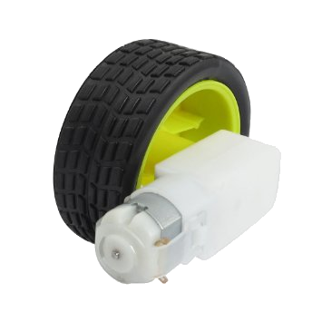
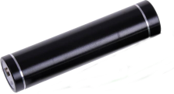
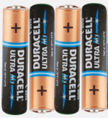
Raspberry Pi Line following Robot Car Wiring Connections
Left DC motor
L298N
Right DC motor
L298N Motor Controller
Left Infrared Sensor
Right Infrared Sensor
+12v Gr +5 v
1 2 3 4
VCC
GPIO 15
GPIO 13
VCC
OUT
GND
OUT
GND
GPIO 6
GPIO 10
GPIO 14
GPIO 2
2
4 6 8 10 12 14 16 18 20 22 24
1 3 5 7 9 11 13 15 17 19 21 23
GPIO 9
GPIO 4
Raspberry Pi
GPIO 7
Pi’s Micro USB Power Connection
USB Portable mobile phone charger
A. Davis issue 1.0 19.02.2015

Slide 2
Raspberry Pi Line following Robot Car Wiring Connections
Chassis View
Left Infrared Sensor
Front
Right Infrared Sensor
OUT
GND
Raspberry Pi
OUT
GND
23 21 19 17 15 13 11 9 7 5 3 1
Forward
24 22 20 18 16 14 12 10 8 6 4 2
Forward
Pin 15
Pin 13
Left DC motor and wheel
L298N
Right DC motor and wheel
L298N Motor Controller
+12v Gr +5 v
1 2 3 4
Left Sensor | Right Sensor | Left Motor | Right Motor
On | On | On | On
Off | Off | Off | Off
On | Off | On | Off
Off | On | Off | On
A. Davis issue 1.0 19.02.2015

Slide 3
Line Following PiBot List of Parts
Device | Website
Raspberry Pi (any version) | Search on Amazon for Raspberry Pi
L298N Motor Controller | Search on Amazon for Raspberry L298N Motor Driver
2WD Beginner Robot Chassis | Search on Amazon of robot chassis kit
GM3 gear motor x 2 | https://www.robotshop.com/uk/solarbotics-gm3-gear-motor-3.html
GMPW wheels x 2 | https://www.robotshop.com/uk/solarbotics-gmpw-gm-plastic-wheel.html
Infrared Sensors | Search on Amazon for Obsidian 5V Infrared Line Track Tracking Tracker Sensor
Battery holder for 4 AA’s | Should come as part of the Robot Chassis kit
4 AA batteries | Any supermarket
Portable mobile phone charger | Search on Amazon for Bonai Portable Phone Charge
USB Power cable | Search on Amazon for USB cable for samsung
Ribbon cable | Search on Amazon for ribbon cable

